Slide 1
TinyLink: A Holistic System for Rapid Development of IoT Applications
Gaoyang Guan, Wei Dong, Yi Gao, Kaibo Fu, Zhihao Cheng
MobiCom’17, October 16-20, 2017, Snowbird, UT, USA
Reviewed and presented by Jingyun Ning (jn2ne@virginia.edu)

Slide 2
Outline
Introduction
Problem Statement
Proposed Method
TinyLink System
System Architecture
Evaluation
Conclusion
1

Slide 3
IoT Applications
2

Slide 4
Problem Statement
Traditional development approach is complex and time-consuming.
Need to know all aspects of IoT system
Hardware and Software are tightly coupled
Project Analysis
Functionality requirements
Hardware platform
Software libraries
Application code
3

Slide 5
TinyLink System
Input: Application code
Outputs:
Configurations for hardware platform
Executable binary code
Project Analysis
Application Code
TinyLink System
Hardware Generation System
Software Generation System
TinyLink Applications
4

Slide 6
Outline
Introduction
Problem Statement
Proposed Method
System Architecture
Hardware and Software Systems
Evaluation
Conclusion
5

Slide 7
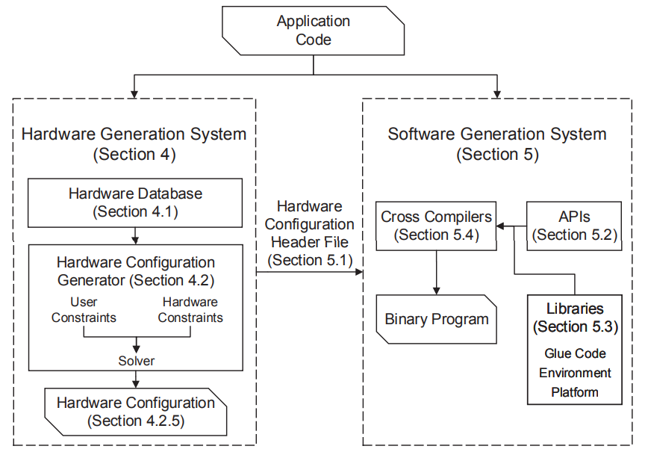
System Architecture
Hardware components & characteristics
6

Slide 8
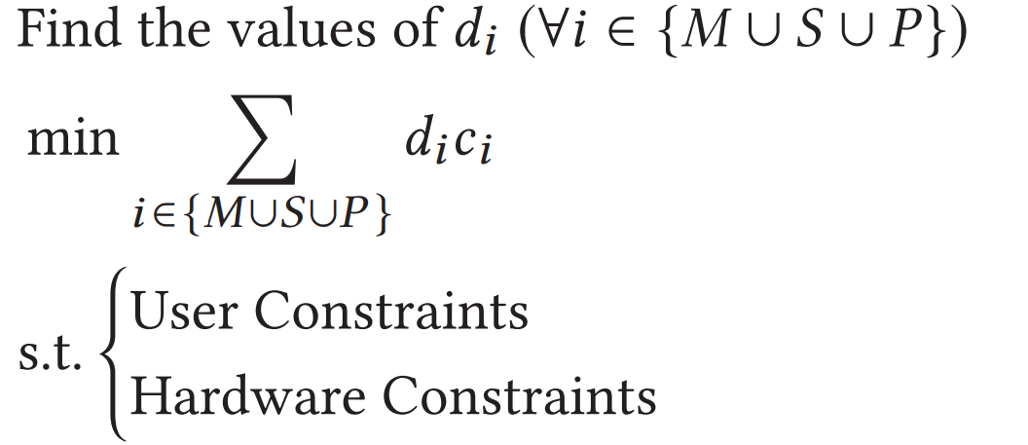
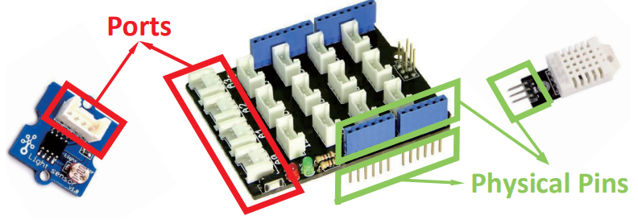
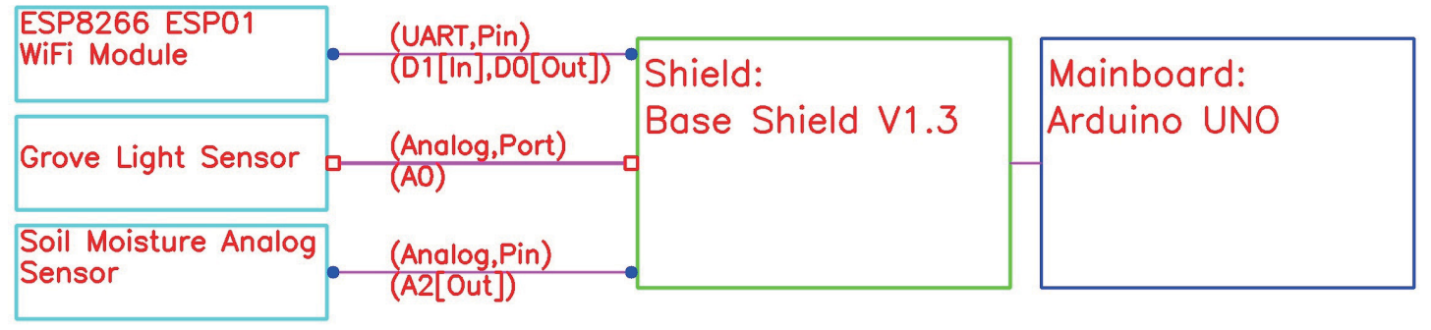

Hardware Configuration Generator
Formulate the problem as an integer linear programming problem
Visualize the recommended hardware configuration
Employ the validation procedure
Provided
number of ports/pins
Consumed
number of ports/pins
Mainboards + Shields + Peripherals
Mainboards + Shields + Peripherals
$$≥$$
7

Slide 9
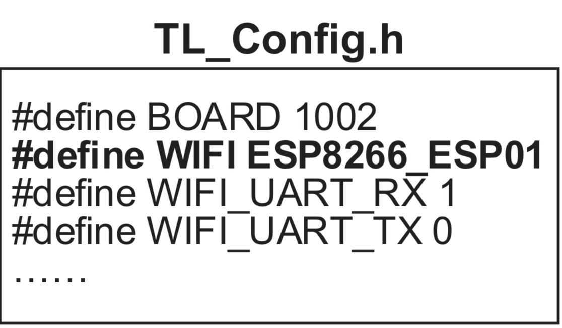
Software Generation System
Hardware configuration header file
Software API
225 commonly used APIs from 116 IoT projects
Library Implementation
Implement the most commonly used libraries
Reuse existing libraries
Make it open-source
Cloud-based compiling
APIs from projects
Implemented projects using TinyLink
10.22%
32.76%
89.78%
67.24%
8

Slide 10
Outline
Introduction
Problem Statement
Proposed Method
TinyLink System
System Architecture
Evaluation
Conclusion
9

Slide 11
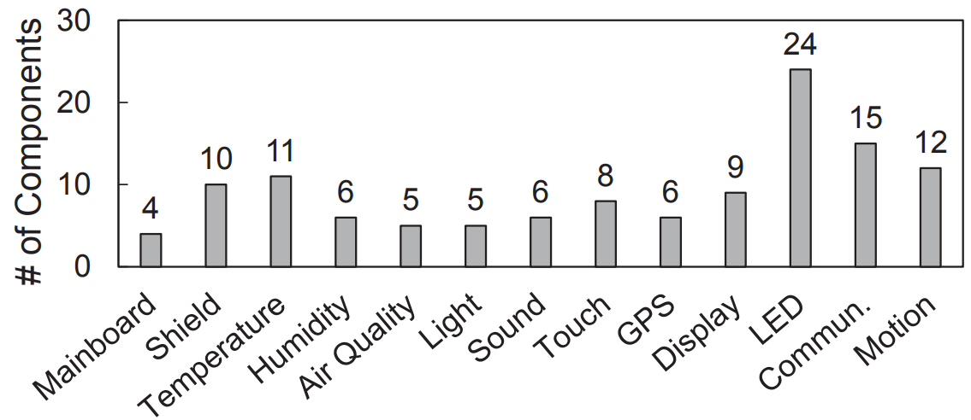
Experiment Setup
Hardware database
Benchmarks
LED Write, WiFi Get, File Write & Read, Temperature Read, Humidity Read, Light Read
10

Slide 12
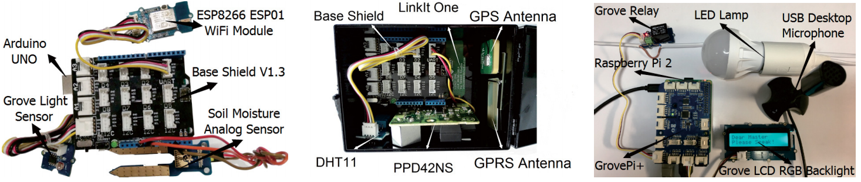
Case Study
Smart houseplant application
Air quality monitoring application
Voice controlled LED lamp application
11

Slide 13
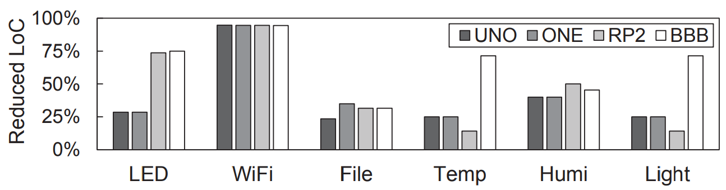
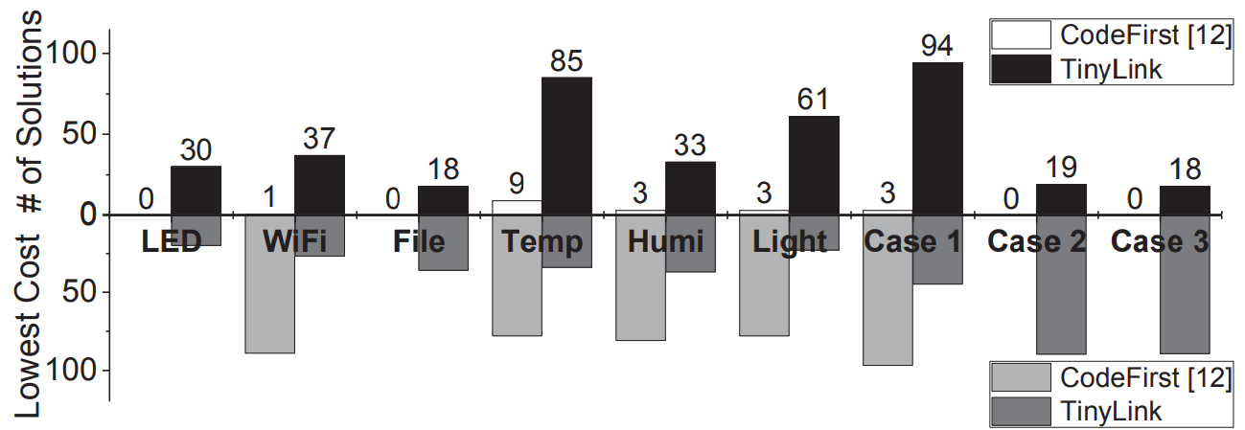
Evaluation
Ease of programming
Feasible solutions
52.8%
Overheads
Execution overhead
Program space overhead
Memory space overhead
12

Slide 14
Outline
Introduction
Problem Statement
Proposed Method
TinyLink System
System Architecture
Evaluation
Conclusion
13

Slide 15
Conclusion
Strengths
Reduce the developing time and total cost of existing applications.
Save local space for both developers and clients.
Provide a large hardware database.
Weaknesses
Is total cost a good optimization criterion? (e.g. security, extensibility)
Need to implement more API to support hardware components.
14

Slide 16
Thank you!

Slide 17
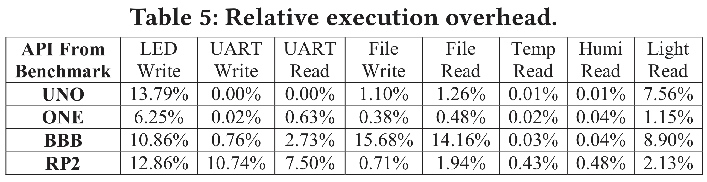
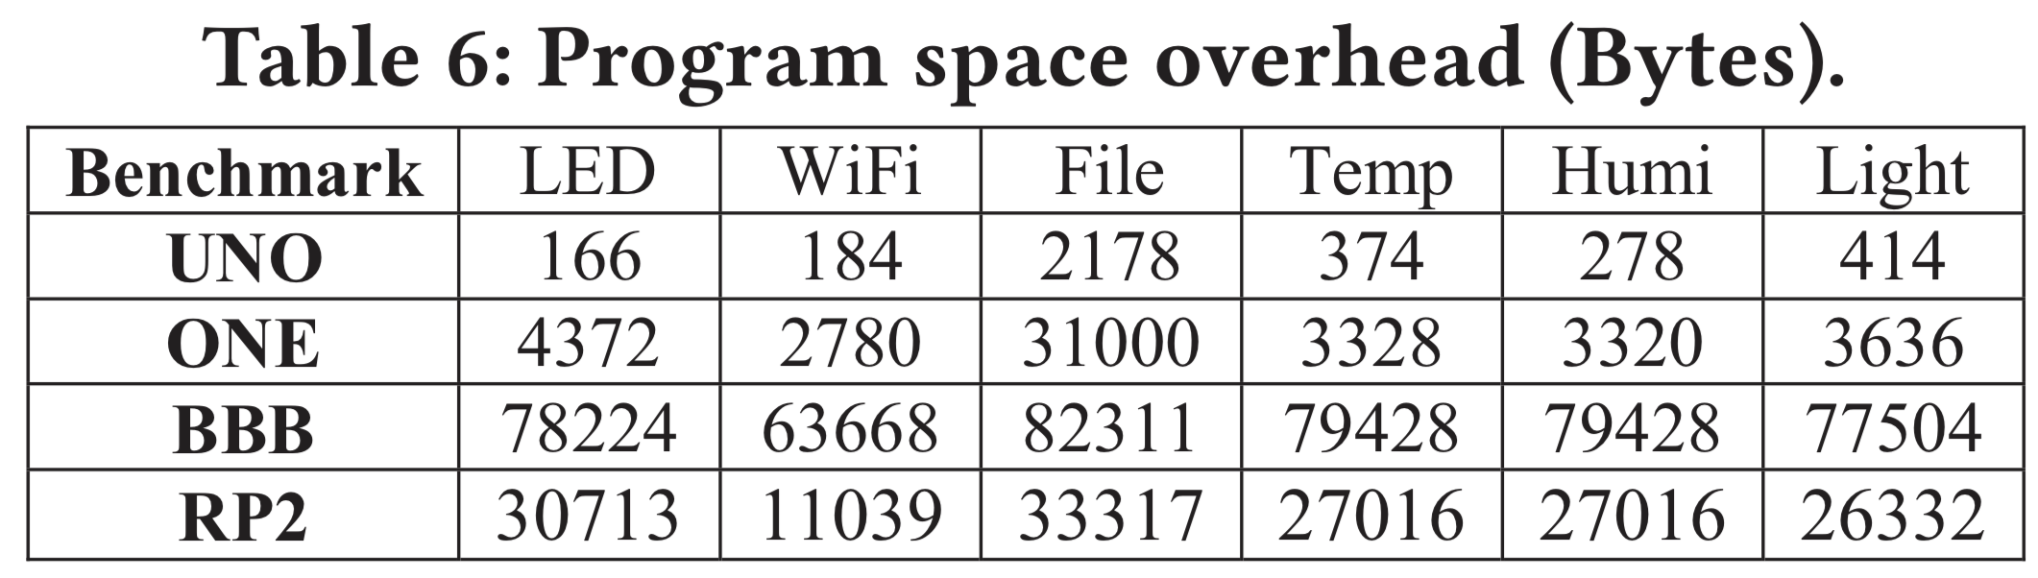
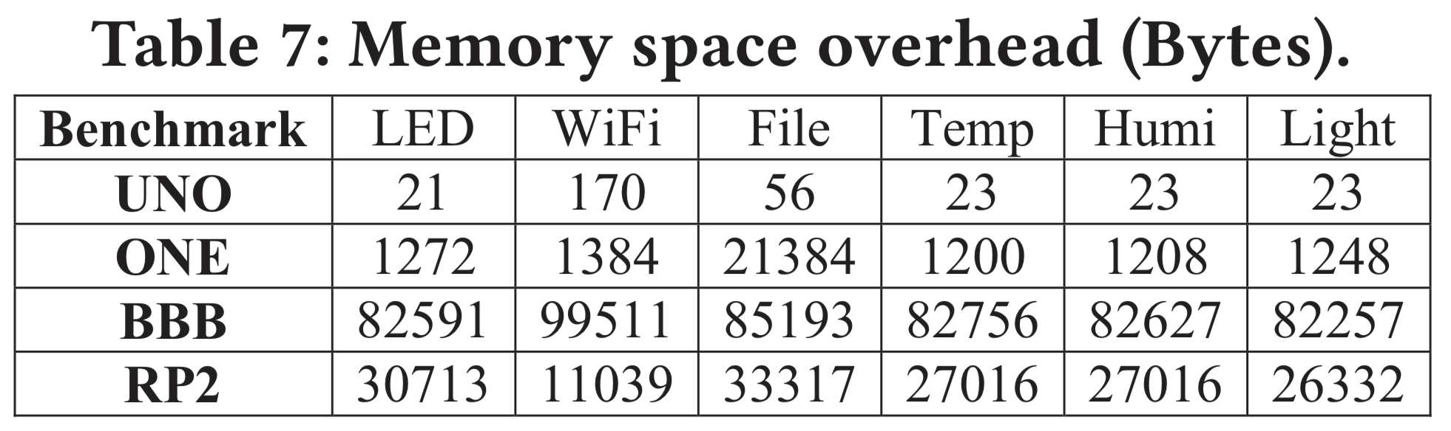
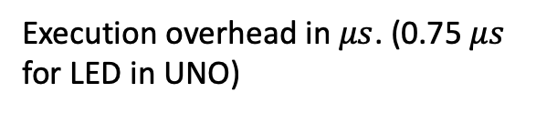
Overhead
Execution overhead in $μs$. (0.75 $μs$ for LED in UNO)
Program flash
UNO: 32KB, ONE: 16MB, BBB & RP2: at least 4GB
UNO: 8.35% of RAM size
ONE: 1.03% of RAM size
BBB: 512MB RAM size
RP2: 1GB RAM size

